Slide 1
Drugs and Sleep: What the Cardiologist should know
Atul.pathak@chpg.mc
@AtulPathak31
Professor Atul PATHAK, MD, PhD.
Head of Cardiovascular Medicine ( Monaco)
Director Research Team CNRS ( from Hypertension to Heart Failure) (France)
Adjunct Professor of Medicine Philadelphia ( USA)
President of the French Society for Hypertension (SFHTA)
Past President of the European Society for Patient Care (SETE)
European
Hypertension
Excellence
Center
Princess Grace Hospital
Monaco

Slide 2
Before knowing if the patient has Sleep Disorders
Drugs adversely affecting OSA thus overstimating severity
Benzodiazepines,
Opioids,
Muscle relaxants,
Male hormones
Testing could be done with (real life setting)
Drugs can be weaned to improve symptoms

Slide 3
Before knowing if the patient has Sleep Disorders
Drugs that do not affect OSA and can even potentially improve respiratory function during sleep underestimating severity :
anti-inflammatory drugs,
diuretics,
bronchodilators,
acetylcholinesterase inhibitors,
antiparkinsonian,
decongestant drugs, drugs for intranasal use,
topical soft tissue lubricant,
female sex hormones.

Slide 4
Once diagnosis has been established
Management of the disease can directly/ indirectly improve sleep pattern:
Central Sleep Apnea and HF
Body weight reduction in HTN or patient with Diabetes
Management of the disease can sometimes avoid / post pone requirement for ventilation

Slide 5
EN FRANCAIS
PEU IMPORTE LE SOMMEIL !!
BENEFICE CV >> RISQUE SOMMEIL
MAIS ADAPATATION POUR AMELIORER LE CONFORT , LES SYMPTOMES ET DONC ADHESION

Slide 6
Alpha Blocker: IMPORTANCE OF CENTRAL EFFECT

Slide 7
Alpha Blocker (false)

Slide 9
Dexmedetomidine cousin de la clonidine

Slide 10
Clondine et Dexmetomidine

Slide 11
Inconsistent Data
One study in hypertensive patients found that clonidine decreased total sleep time, however another study in healthy patients showed that clonidine increased total sleep time.
Another study reported that clonidine suppressed rapid eye movement (REM) sleep and the apneas occurring during REM, which decreased nocturnal hypoxemia.
Despite the inconsistent data on the effects of the alpha adrenergic agonists on sleep quality it is clear that the class exhibits a high degree of CNS effects.
MESSAGE FOR CARDIOLOGIST :
As such, these agents probably should not be considered preferred agents for hypertension, particularly in the geriatric population and specially if OSA / Anesthesia.

Slide 12
AAR

Slide 13
Class I AA: No Problem
Class I
Few studies showing any negative effects of the Class I antiarrhythmics on sleep quality.
Propafenone states that insomnia occurs in 1-2% of patients, with fatigue occurring in 2-6% and drowsiness occurring in 1% of patients.
Despite paucity of association it seems prudent to discuss these adverse reactions with patients and the geriatric subset of patients in particular

Slide 14
Class II: Beta Blockers all about PK
Drug – Drug interaction
Polymorphism
Half life

Slide 15
Beyond sleep CNS side effects with impact on sleep (complex semiology)

Slide 16
AA Class III: No problem
Amiodarone This agent is known to have a plethora of adverse reactions, many of them serious. CNS effects, including insomnia, fatigue and other sleep disturbances are described as occurring in 3% to 40% of patients in the package labeling and neurologic side effects were reported in the literature in 20-40% of patients.
Dronedarone This is the newest agent of the class and while it has decreased efficacy over amiodarone, it also has decreased adverse reactions, including no known adverse effects on sleep quality or architecture. Dofetilide There are no published studies detailing any association between dofetilide and negative sleep quality; however, the package labeling states that insomnia occurs in 4% of treated patients.
Sotalol 8% occurrence of undefined sleep problems; however a very small published study which evaluated the effects of sotalol 320mg or 960mg on the CNS via sleep, EEG, and psychophysiological parameters showed no difference between the two treated groups.
The Class III agents, although similarly classed, have vastly different associations with sleep disturbance and sleep quality.

Slide 17
Class IV: Non-dihydropyridine Calcium Channel Blockers, NO PROBLEM
Diltiazem and Verapamil: no data indicating an association between diltiazem and sleep disturbance and although sleep disturbance is listed as a potential adverse effect in the product labeling of verapamil, it is not known to be a common side effect, occurring in less than 1% of patients treated.
BUT VERAPAMIL inhibits CYP450 3A4 and can increase plasmatic concentration of drugs affecting sleep

Slide 18
RAS blocking agent

Slide 19
Angiotensin Converting Enzyme (ACE) Inhibitors / ARB
ACE inhibitors are thought to negatively affect sleep in some patients by increasing the amount of circulating bradykinin.
The associated cough and rhinopharyngeal inflammation induced by the bradykinin may worsen the AHI.
Additionally, ACE inhibitors may affect potassium levels, potentially leading to leg cramps as well as painful joints and muscles in some patients.
Since these side effects do not affect all patients, clinicians should discuss them with patients and adjust therapy accordingly if necessary, to avoid sleep disturbances.

Slide 20
In this trial , SV treatment for 3 months in SA patients is associated with a significant decrease in AHI. These results support the current guidelines that recommend first an optimization of the HFrEF treatment in patients with HFrEF and central SA. A potential positive airway pressure sparing effect merits further investigation.

Slide 21
MRA and OSA in refractory HTN

Slide 22
HMG Co-A Reductase Inhibitors: PK again
These agents are known to cause muscle pain which may affect sleep quality by not allowing patients to fall asleep and stay asleep ? SAMSON study no !
Lipophilic type HMG Co-A reductase inhibitors may cause a disturbance in sleep architecture and cause insomnia or nightmares via their increased penetration of the BBB.
If difficulties with sleeping, it may be prudent to switch to a hydrophilic agent preferentially.

Slide 24
And beyond

Slide 25
Medication causing insomnia

Slide 26
Drugs increasing weight and OSA symptoms/ severity
Kushner et al. 2014

Slide 27
IMPORTANT FOR CARDIOLOGIST: Drugs for Residual Sleepiness
Drugs for residual sleepiness:
All sympathomimetic drugs
Sympathomimetic effects
Management of CV risk
Management of target organ

Slide 28
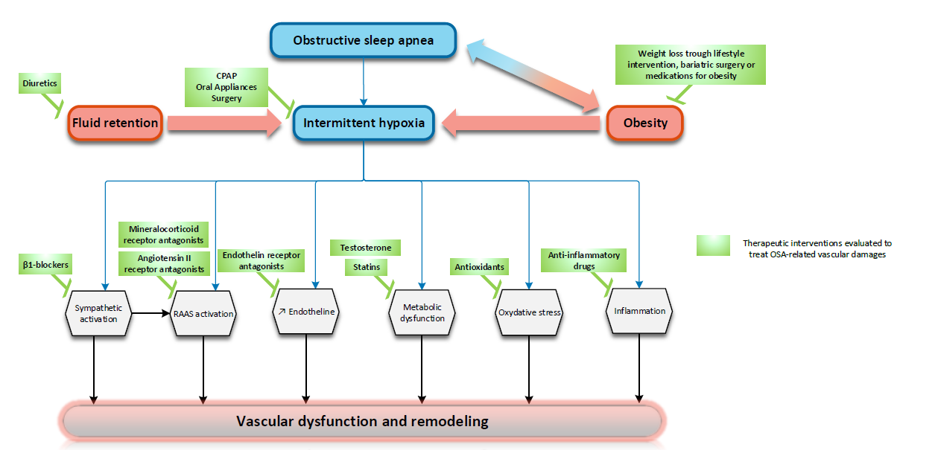
CV drugs and SBD (cause / consequences)

Slide 29
Strategies to prevent Drug – induced sleep risk
BENEFIT RISK RATION MATTERS
Step 1: Identify patients at risk
Step 2: Modify treatment accordingly
Review current drug therapy
Change in patient status
Indication no longer exists
Safer agent available
Drug interactions
Drug adverse effects
Simplification
Discontinue unnecessary therapy
Consider ADE as cause of any new symptom
Consider non-pharmacologic approaches
Notes:
Pharmacists trained in systematic medication review
Providers often reluctant to stop medications, especially if they did not initiate the treatment and patient seems to be tolerating. SOmetimes this exposes patient to risk without therapeutic benefit.
Treatment goals may not may not be appropriate for older adults. Life expectancy/prognosis may influence goals. E.g. BP, HgA1c

